Slide 1
Logistic Regression
Session 07-08

Slide 2
Learning Outcome
LO 1: Explain the fundamental of machine learning concept
LO 2: Interpret the distribution of dataset using regression method
LO 3: Experiment classification and clustering algorithm from given dataset

Slide 3
Outline
Generative and Discriminative Model
Logistic Regression
Evaluation Measure for Classification

Slide 4
Generative and Discriminative Model

Slide 5
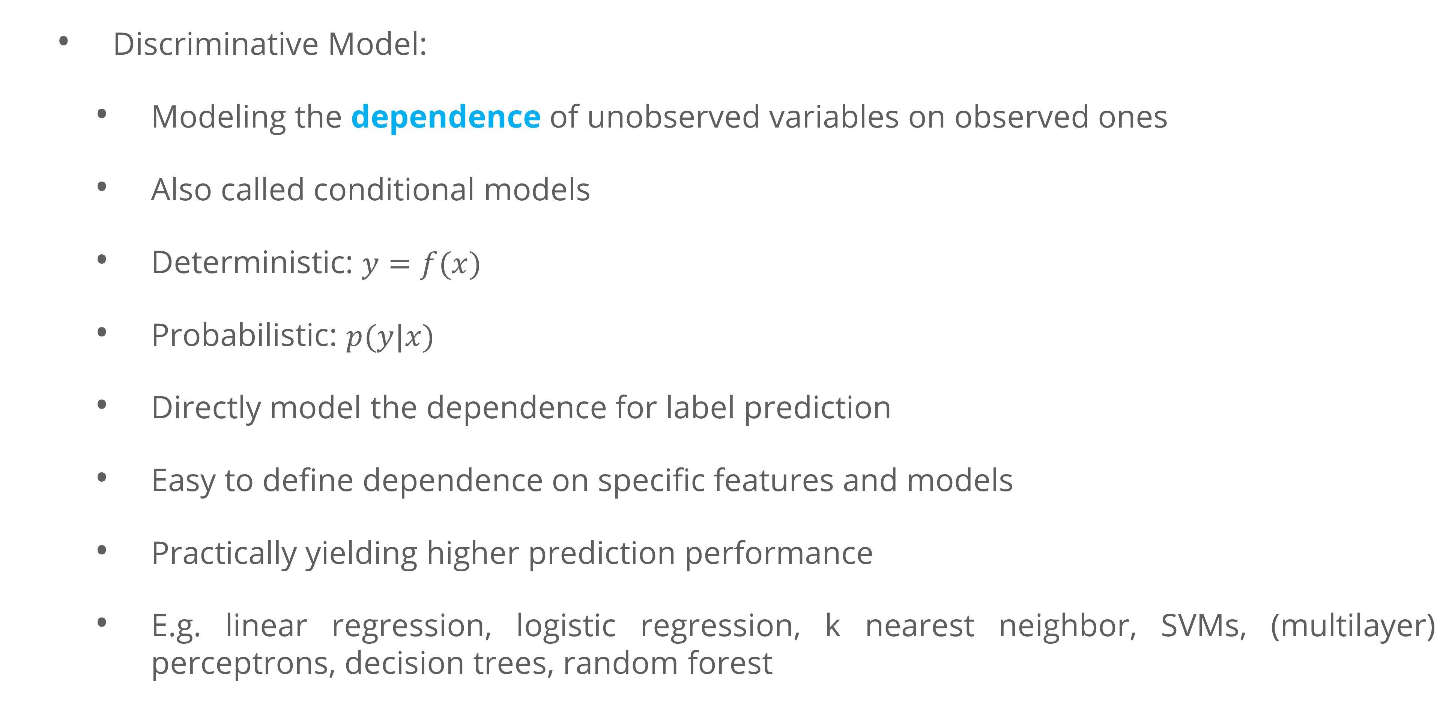
Generative and Discriminative Model
Discriminative Model:
Modeling the dependence of unobserved variables on observed ones
Also called conditional models
Deterministic: $y=f(x)$
Probabilistic: $p(y|x)$
Directly model the dependence for label prediction
Easy to define dependence on specific features and models
Practically yielding higher prediction performance
E.g. linear regression, logistic regression, k nearest neighbor, SVMs, (multilayer) perceptrons, decision trees, random forest

Slide 6
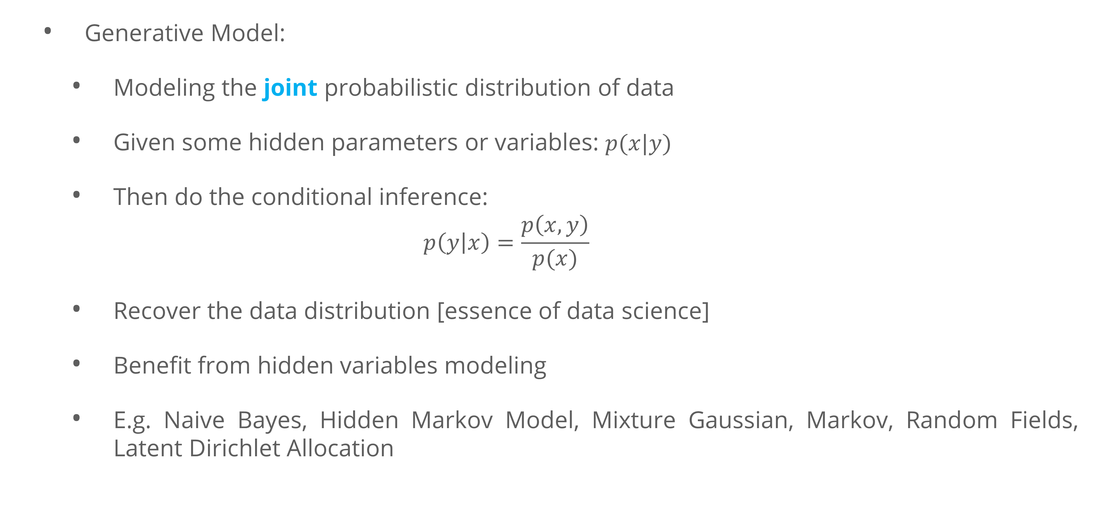
Generative and Discriminative Model
Generative Model:
Modeling the joint probabilistic distribution of data
Given some hidden parameters or variables: $p(x|y)$
Then do the conditional inference:
$$p\left(y | x\right)=\frac{p\left(x,y\right)}{p(x)}$$
Recover the data distribution [essence of data science]
Benefit from hidden variables modeling
E.g. Naive Bayes, Hidden Markov Model, Mixture Gaussian, Markov, Random Fields, Latent Dirichlet Allocation

Slide 7
Generative and Discriminative Model
In general:
A Discriminative model models the decision boundary between the classes
A Generative Model explicitly models the actual distribution of each class
Example : Our training set is a bag of fruits. Only apples and oranges Each labeled. Imagine a post-it note stuck to the fruit
A generative model will model various attributes of fruits such as color, weight, shape, etc
A discriminative model might model color alone, should that suffice to distinguish apples from oranges

Slide 8
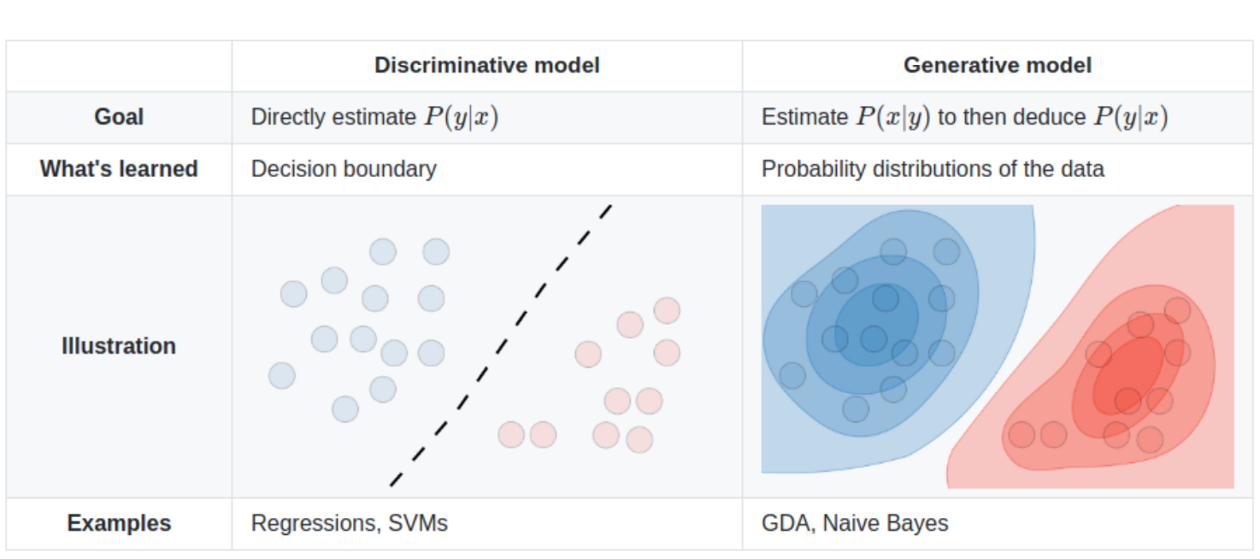
Generative and Discriminative Model

Slide 9
Logistic Regression

Slide 10
Logistic Regression
Logistic Regression:
Like linear regression
Given the numerical features of a sample, predict the numerical label value
E.g. given the size, weight, and thickness of the cell wall, predict the age of the cell
The values 𝑦 we now want to predict take on only a small number of discrete values

Slide 11
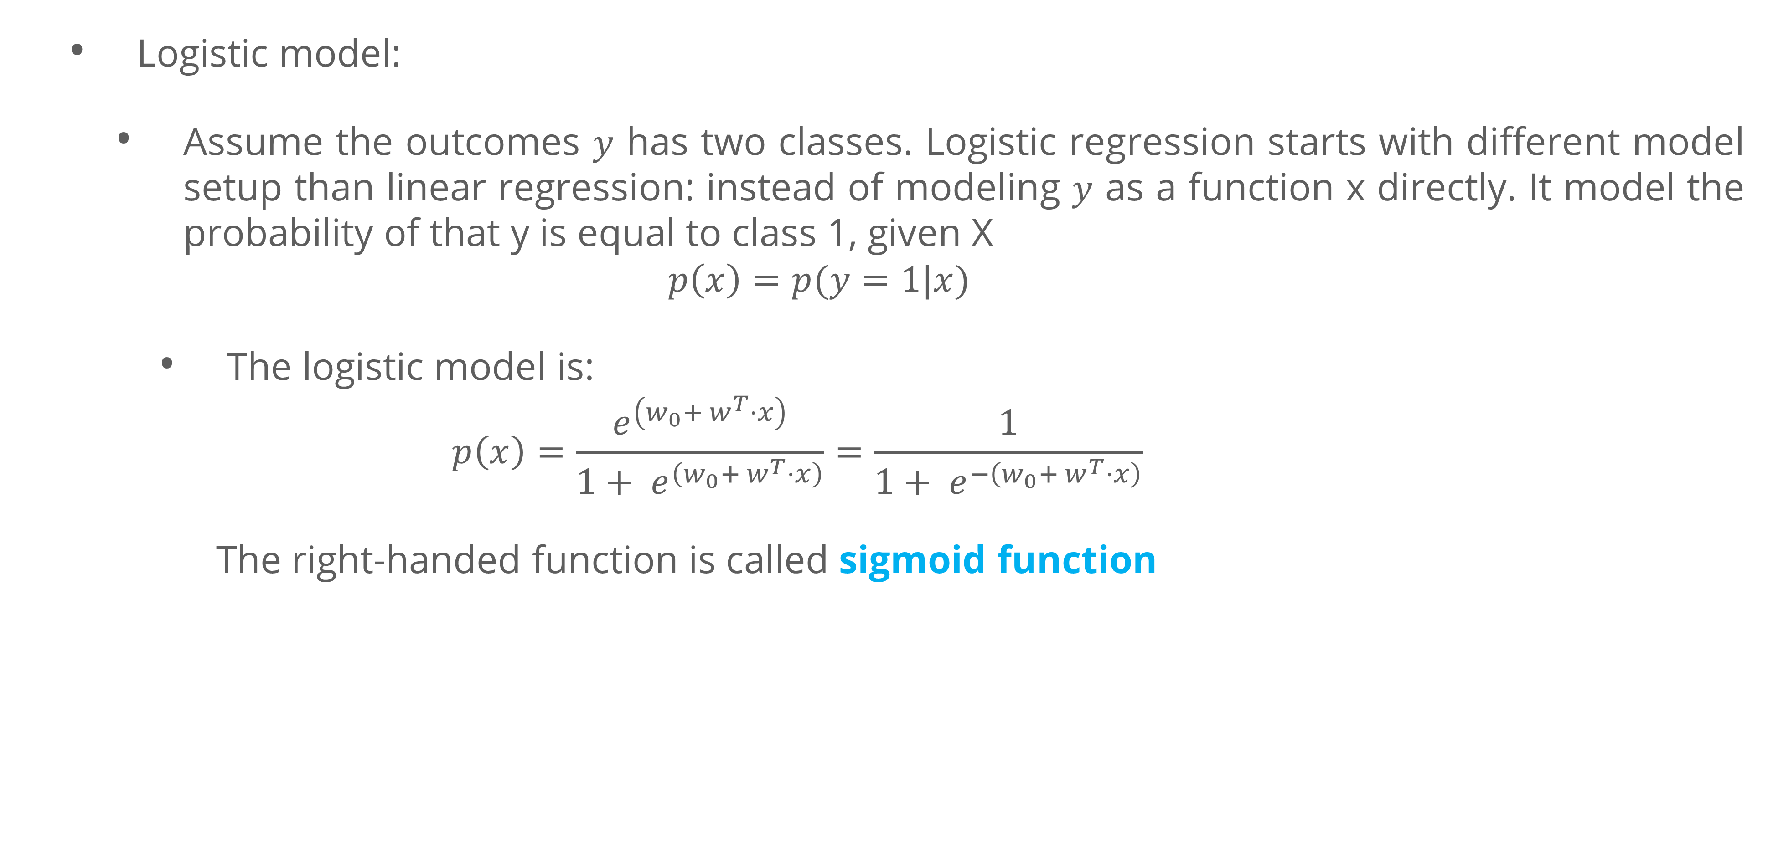
Logistic Regression
Logistic model:
Assume the outcomes $y$ has two classes. Logistic regression starts with different model setup than linear regression: instead of modeling $y$ as a function x directly. It model the probability of that y is equal to class 1, given X
$$p\left(x\right)=p(y=1|x)$$
The logistic model is:
$$p\left(x\right)=\frac{e^{\left(w_{0}+ w^{T}⋅x\right)}}{1+ e^{\left(w_{0}+ w^{T}⋅x\right)}}=\frac{1}{1+ e^{−\left(w_{0}+ w^{T}⋅x\right)}}$$
The right-handed function is called sigmoid function

Slide 12
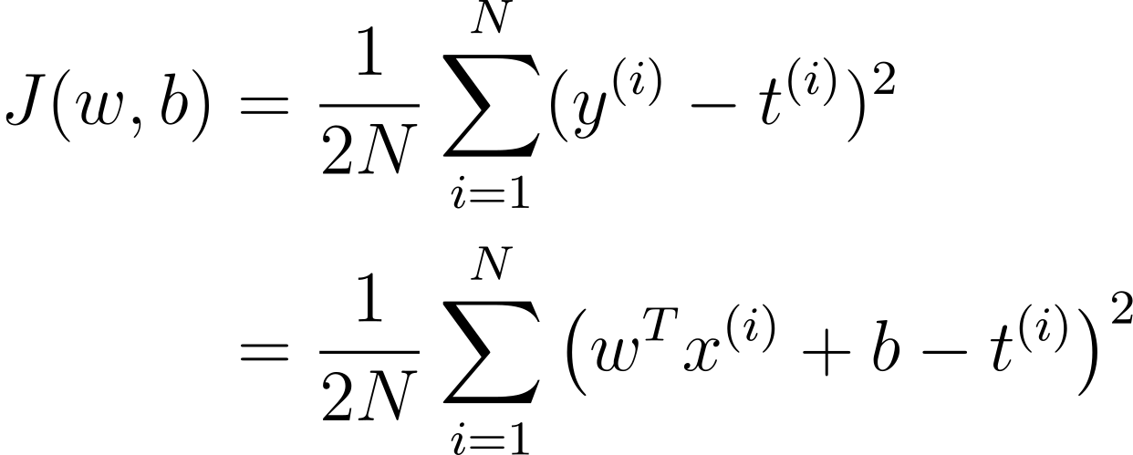
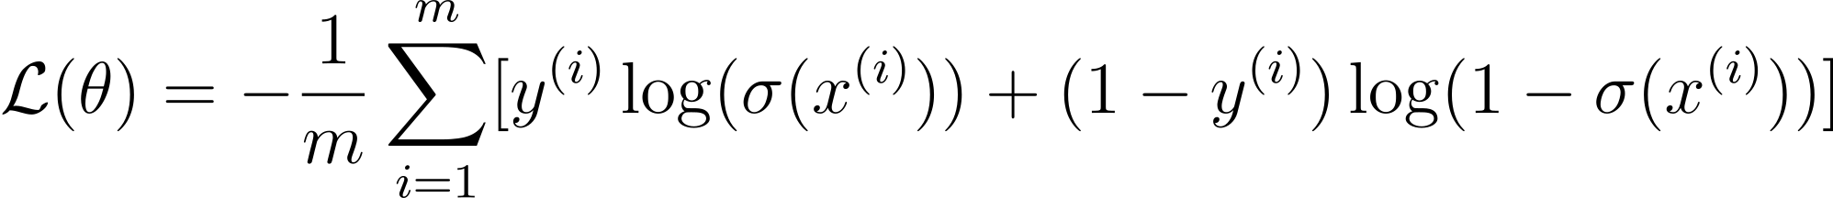
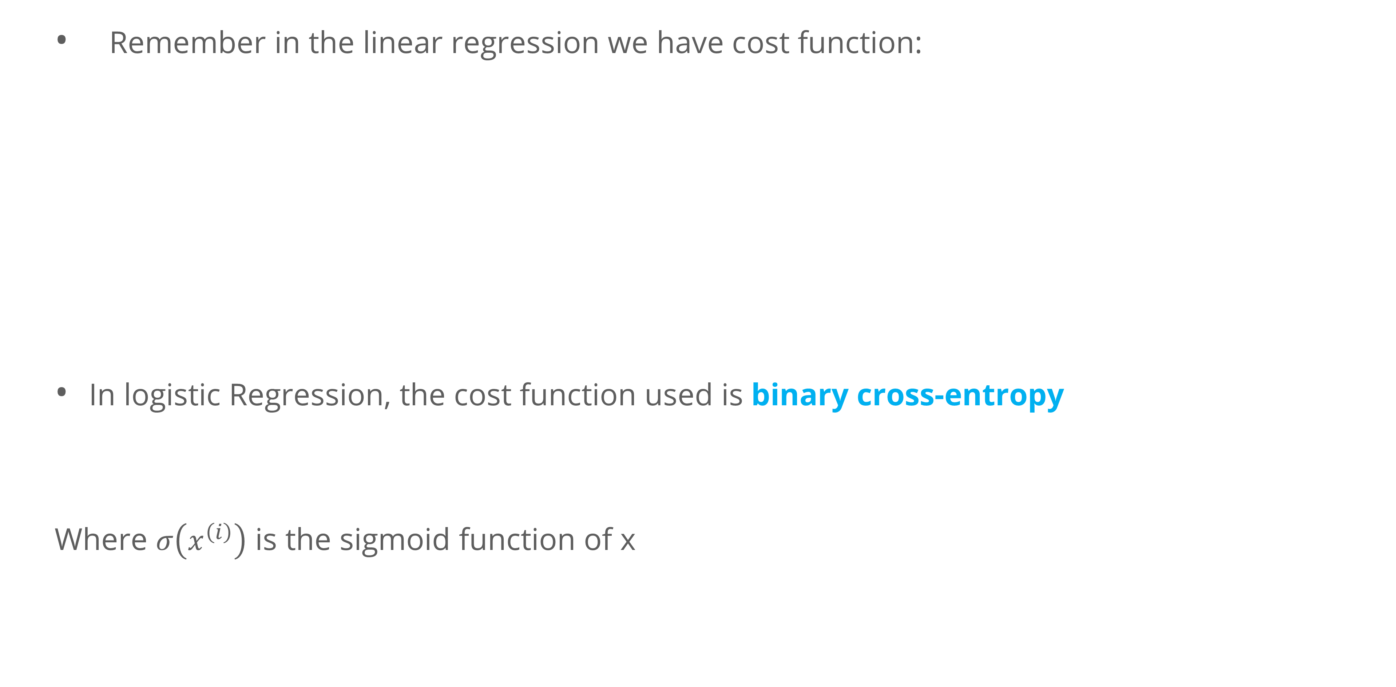
Logistic Regression
Loss Function
Remember in the linear regression we have cost function:
In logistic Regression, the cost function used is binary cross-entropy
Where $σ\left(x^{\left(i\right)}\right)$ is the sigmoid function of x

Slide 13
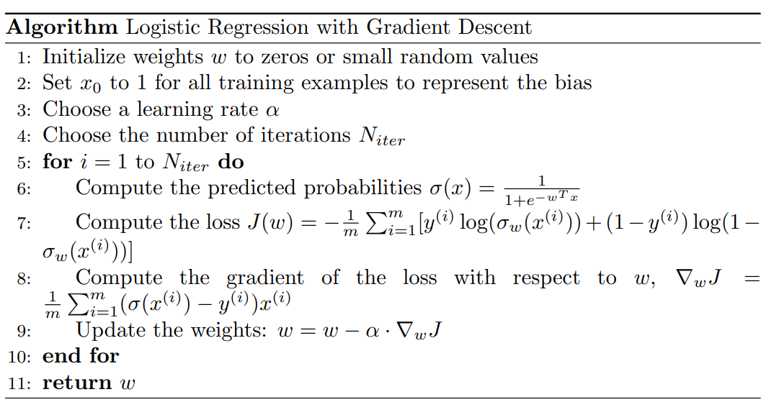
Logistic Regression
Algorithm

Slide 14
Evaluation Metric

Slide 15
Evaluation Metric
Typical evaluation metric for Classification problems:
Confusion matrix
Accuracy, Precision, Recall, F1-Score
ROC-Curve

Slide 16
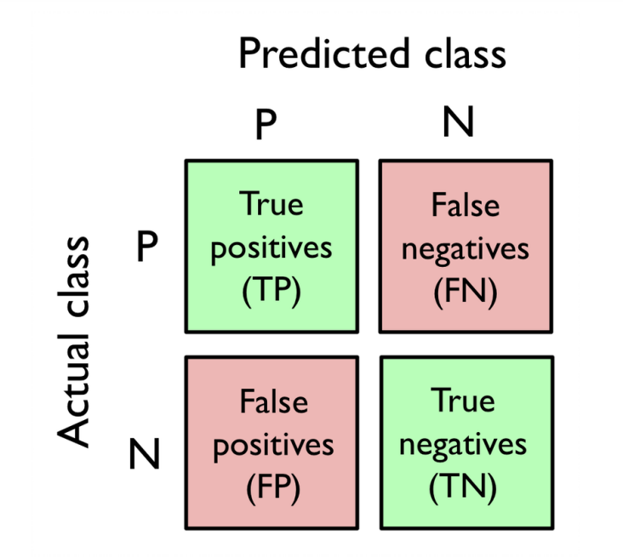
Evaluation Metric
Confusion Matrix
A Confusion matrix is an N x N matrix used for evaluating the performance of a classification model, where N is the number of target classes
A confusion matrix is a tabular summary of the number of correct and incorrect predictions made by a classifier.
Basic Terminology Confusion Matrix:
True Positives (TP): when the actual value is Positive and predicted is also Positive.
True negatives (TN): when the actual value is Negative and prediction is also Negative.
False positives (FP): When the actual is negative but prediction is Positive. Also known as the Type 1 error
False negatives (FN): When the actual is Positive but the prediction is Negative. Also known as the Type 2 error

Slide 17
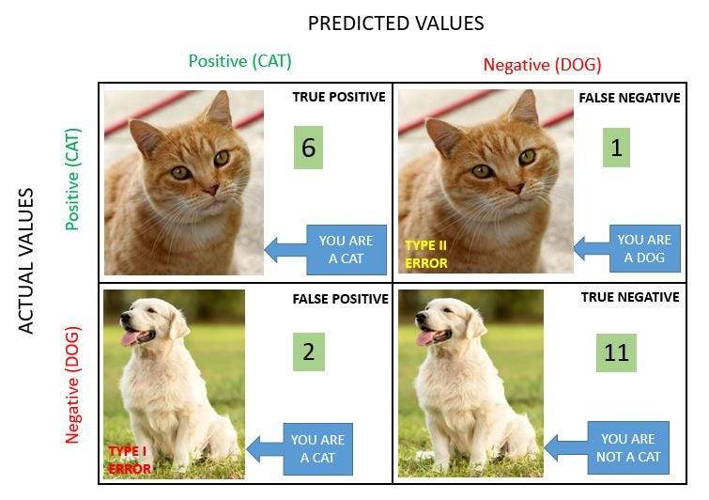
Evaluation Metric
Confusion Matrix

Slide 18
Evaluation Metric
Confusion Matrix
Confusion matrices are widely used because they give a better idea of a model’s performance than classification accuracy does.
If you have an imbalanced dataset to work with, it’s always better to use confusion matrix as your evaluation criteria for your machine learning model.

Slide 19
Evaluation Metric
Accuracy
Accuracy simply measures how often the classifier makes the correct prediction. It’s the ratio between the number of correct predictions and the total number of predictions.
The accuracy metric is not suited for imbalanced classes.
Accuracy is a valid choice of evaluation for classification problems which are well balanced and not skewed or there is no class imbalance.

Slide 20
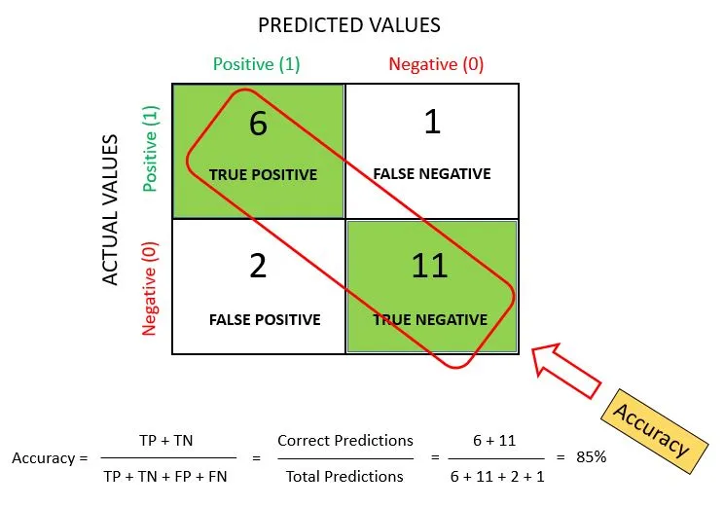
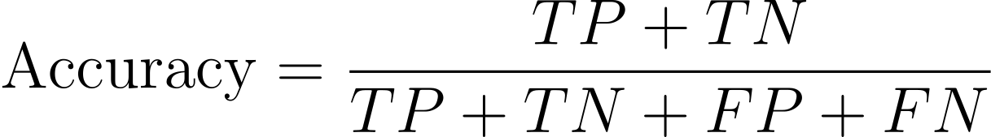
Evaluation Metric
Accuracy

Slide 21
Evaluation Metric
Precision
It is a measure of correctness that is achieved in true prediction. it tells us how many predictions are actually positive out of all the total positive predicted.
Precision is a useful metric in cases where False Positive is a higher concern than False Negatives
Example:
Scenario: Consider a medical test for a non-life-threatening condition that has significant side effects from treatment.
Problem: In such cases, a false positive — wrongly diagnosing a healthy person as sick — can lead to unnecessary treatment, causing avoidable side effects and stress. It may also lead to further unnecessary tests and procedures that carry their own risks.

Slide 22
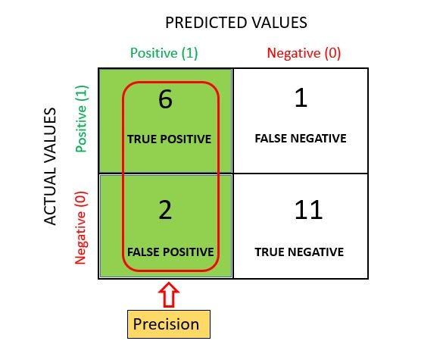
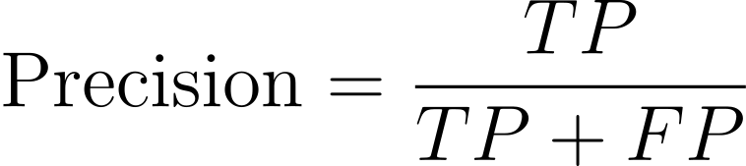
Evaluation Metric
Precision

Slide 23
Evaluation Metric
Recall-
It is a measure of actual observations which are predicted correctly, i.e. how many observations of positive class are actually predicted as positive.
It is also known as Sensitivity.
Recall is a useful metric in cases where False Negative trumps False Positive
Example:
Scenario: Airport security screenings for weapons or explosives.
Problem: A false negative, where a dangerous item is not detected, could result in a security breach with potentially catastrophic consequences.

Slide 24
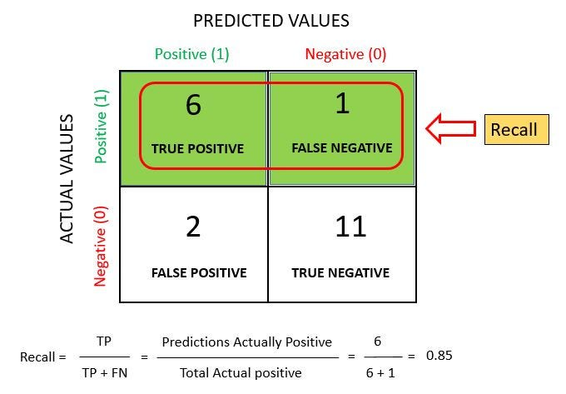
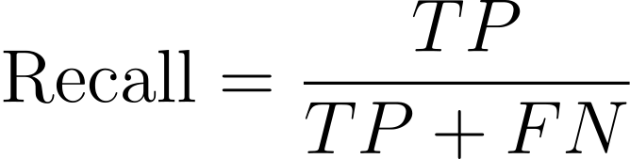
Evaluation Metric
Recall

Slide 25
Evaluation Metric
F1-Score
The F1 score is a number between 0 and 1 and is the harmonic mean of precision and recall. We use harmonic mean because it is not sensitive to extremely large values, unlike simple averages.
F1 score sort of maintains a balance between the precision and recall for your classifier.

Slide 26
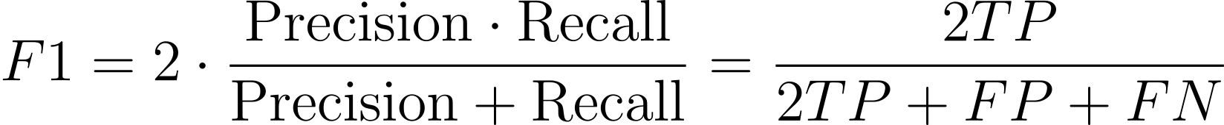
Evaluation Metric
Recall

Slide 27
Evaluation Metric
Receiver Operating Characteristic (ROC) curves
An ROC curve (receiver operating characteristic curve) is a graph showing the performance of a classification model at all classification thresholds.
This curve plots two parameters:
True Positive Rate (TPR) is a synonym for recall and is therefore defined as follows:
False Positive Rate (FPR)
ROC graphs are two-dimensional graphs in which TP rate is plotted on the Y axis and FP rate is plotted on the X axis.
An ROC graph depicts relative tradeoffs between benefits (true positives) and costs (false positives).

Slide 28
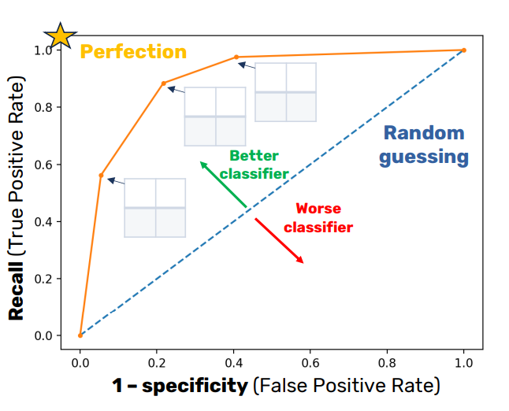
Evaluation Metric
Receiver Operating Characteristic (ROC) curves
(1,1)
Observations:
(0,0): classifying always negative
(1,1): classifying always positive
Diagonal line: random classifier
Below diagonal line: worse than random classifier
Different classifier can be compared
Area Under the Curve (AUC): probability that a randomly chosen positive instance will be ranked ahead of randomly chosen negative instance
(0,0)

Slide 29
Exercise

Slide 30
Exercise
You are a data scientist tasked with analyzing the Titanic dataset. The ultimate goal of your analysis is to build a model that can predict which passengers survived the Titanic disaster (https://www.kaggle.com/competitions/titanic). Your objective is to build a logistic regression model to predict the binary outcome of survival for the Titanic passengers.
Split the dataset into a training set and a testing set to evaluate your model's performance (70:30).
Develop a logistic regression model using your selected features.
Evaluate the performance of your logistic regression model using metrics such as accuracy, precision, recall, and the ROC-AUC score.
Provide a detailed analysis of the confusion matrix to understand the true positives, false positives, true negatives, and false negatives.

Slide 31
References

Slide 32
References
Barsky, M. (2012). ROC Curves [CSCI 485: Data mining]. http://csciun1.mala.bc.ca:8080/~barskym/teaching/DM2012/lectures/Lecture11.ROCcurves.pdf
Chan, S. (2020). Lecture 14 Logistic Regression. ECE595 / STAT598: Machine Learning I. https://engineering.purdue.edu/ChanGroup/ECE595/files/Lecture14_logistic.pdf
Ferramosca, A. (n.d.). Performance metrics. DYNAMIC SYSTEMS IDENTIFICATION COURSE. Retrieved November 14, 2023, from https://cal.unibg.it/wp-content/uploads/DSI/slide/Lecture-06-Metrics.pdf
James, G., Witten, D., Hastie, T., Tibshirani, R., & Taylor, J. E. (2023). An introduction to statistical learning: With applications in Python. Springer.
Li, S. (2019). Logistic Regression. VE445: Introduction to Machine Learning. https://shuaili8.github.io/Teaching/VE445/L4_logistic%20regression.pdf
Raschka, S. (2020). Model Evaluation 5: Performance Metrics. STAT 451: Machine Learning,. https://sebastianraschka.com/pdf/lecture-notes/stat451fs20/12_eval5-metrics__slides.pdf
Suresh, A. (n.d.). What is a confusion matrix? Medium. Retrieved November 15, 2023, from https://medium.com/analytics-vidhya/what-is-a-confusion-matrix-d1c0f8feda5

